Slide 1
Employer obligations: Contributions & LGPS31 Forms
Employer Forum 2022
Dillon Piggott
CIPFA Accounts and Investments Apprentice

Slide 2
What we’ll cover
Employer Forum 2022
LGPS forms & i-Connect
LGPS forms – what we require
Checks we perform
Cheque Payers
Payments

Slide 3
LGPS forms & i-Connect
Employer Forum 2022
Please keep sending in LGPS 31 forms alongside i-Connect submissions
This allows us to match i-Connect data to LGPS data while in the transition period

Slide 4
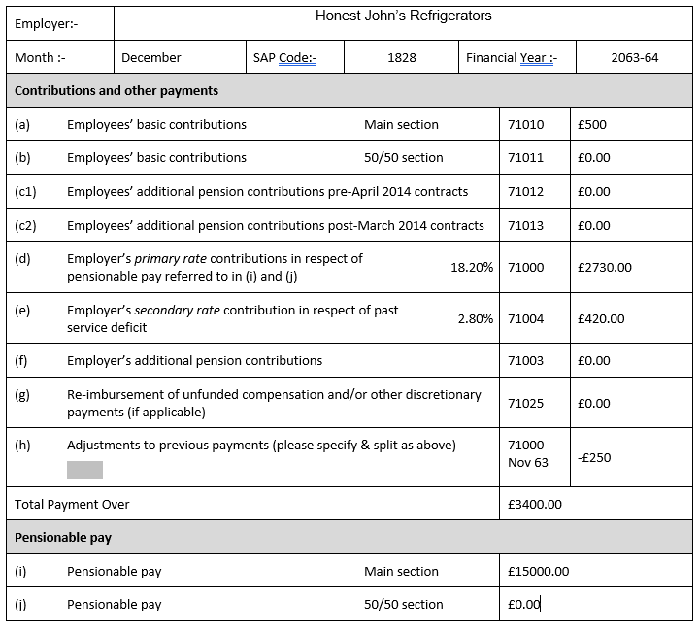
LGPS forms – what we require
Employer Forum 2022
Make sure all amounts are in the correct sections
Check the Month figure is correct before submitting
Split the Employer % as per the values listed – we need this split for reporting purposes
If making an adjustment, please list the code and a brief description of what the payment relates to

Slide 5
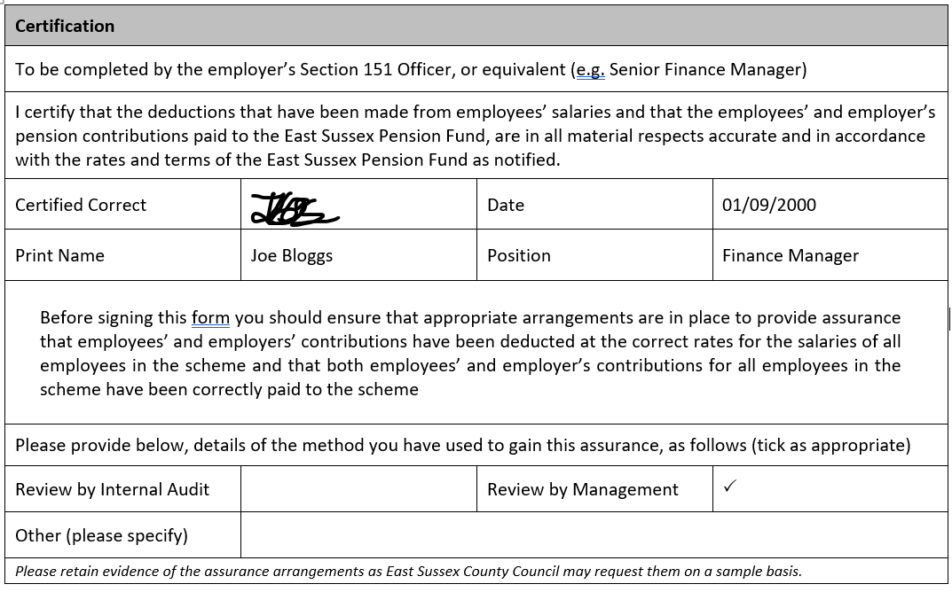
LGPS forms – what we require
Employer Forum 2022
Make sure the Certified correct section is signed by someone on the Authorised signatory list
Make sure at least one of the assurance sections is confirmed

Slide 6
LGPS forms – what we require
Employer Forum 2022
Forms should be emailed to the LGPS mailbox by the 18th of the following month
Payments should be received by no later than the 19th of the following month
Please send the form and payments around the same time
If sending in forms and payments by post, these should be sent in advance to allow for delivery time
If the 18th/19th fall on a public holiday or weekend, they should be sent earlier
Repeated late payments or forms within a 12 month window may result in an administration charge
We will send reminders throughout the month to prompt you

Slide 7
Checks we perform
Employer Forum 2022
Total Payment Figure
Employers Primary/ Secondary Figure
Please test these yourself

Slide 8
Cheque payers
Employer Forum 2022
If handing in forms and cheques by post, allow enough time for delivery
Send an accompanying scanned copy of the form to the employer engagement inbox, with a date that the form was posted
Preferably, please send any payments via BACS. We’re willing to assist with setting this up if required
Please send all cheques by recorded or special delivery so they can be tracked

Slide 9
Payments
Employer Forum 2022
Make sure the payment matches the ‘total payment over’ figure on the LGPS31 form
If possible, please make the reference easy for us to allocate (include the month the payment relates to, as well as sap code or employer name)

Slide 10
Summary
Employer Forum 2022
Double check forms prior to sending
Send in advance of deadlines (Form 18th, Payment 19th)
Any problems, Please reach out:
Employer.engagement@eastsussex.gov.uk
ESCC.PensionsLGPS31@eastsussex.gov.uk

Slide 11
Questions?
Employer Forum 2022

