Slide 1
Administration Key Tasks
Presented by Jennie Shuttleworth and Julie Pelham
Pensions Administration Managers

Slide 2
Agenda
Employer Forum 2022
Providing data to the administration team
Importance of Final Pay Calculations
85 Year Rule
Impact of changing payroll references/numbers

Slide 3

Providing Data to the Admin Team
Employer Forum 2022
As the employer, you have a responsibility to provide the pensions admin team with accurate data.
Here’s some of the most common reasons:
New joiners to the scheme
Any changes to a scheme members personal details
Any changes to contractual hours
Any changes to pay and contribution rates (e.g opting into 50/50 scheme)
Any leavers (pensionable post)

Slide 4
Final Pay Calculations
Employer Forum 2022
Final pensionable pay is based on either the pay due for the member's final year of scheme membership on which they paid contributions or, if it's higher, one of the previous 2 years.
This includes: their normal pay, contractual shift allowance, bonus, contractual overtime (but not non-contractual overtime), Maternity Pay, Paternity Pay, Adoption Pay, Shared Parental Pay, any other taxable benefit specified in their contract as being pensionable.
If their pay in the final year was reduced because of sickness or relevant child related leave, Final Pay is the pay they would have received had they not been on sick leave or relevant child related leave. Known as Assumed Pensionable Pay (APP)
No sum may be taken into account in calculating Final pensionable pay unless income tax liability has been determined on it.
The meaning of Pensionable Pay is set out in Regulation 4 of the Benefit Regulations 2007.
You can find more information on final pensionable pay in the Payroll and HR guides on Forms and Publications | East Sussex Pension Fund

Slide 5
Final Pay Example
Employer Forum 2022
Example : Member retired 31 August 2022
Rates of Pensionable Pay earned over the last years (using the 2008 Scheme definition) were:
1 April 2021 £16,440 pa
1 April 2022 £17,400 pa
Final Year
Date Pay Total
1 September 2021 – 31 March 2022 £16,440/12 x 7 months = £9,590
1 April 2022 – 31 August 2022 £17,400/12 x 5 months = £7,250
Final pay = £16,840 pa

Slide 6

85 Year Rule Protections
If a scheme member joined the LGPS before 01/10/2006
The 85 year rule is satisfied when:
their age
+
their calendar length of scheme membership
(BOTH in full years)
Add up to 85
For example if they have at least 25 years of scheme membership at age 60.
Protections do not apply in full if benefits drawn voluntarily before age 60.
Employer Forum 2022

Slide 7
85 Year Rule Protections
Employer Forum 2022
If the scheme member voluntarily retires on or after age 60 and satisfy the 85 year rule:
Any benefits built up before April 2008 will not be reduced
Additional protections apply based on their age:
If they were born before 1 April 1956 then the benefits they build up to 31 March 2016 will not be reduced
If they:
Turn 60 between 1 April 2016 and 31 March 2020
AND satisfy the 85 year rule before 1 April 2020
The benefits they have built up between 1 April 2008 and 31 March 2020 will have a lower reduction than would apply to a non-protected member
Protections do not apply in full if benefits drawn voluntarily before age 60.
The rules governing how the 85-year rule works and the level of protection are complex, so contact the pension fund for further clarification.

Slide 8
Impact of changing job roles on your LGPS records
Employer Forum 2022
People move roles with an employer on a regular basis. This could be because of restructure, sideways move, promotion, or other reasons.
When this happens, your employer may provide you with a new payroll reference or post number. This information is then given to your pension provider to process.
East Sussex Pension Fund must follow strict guidelines laid down via legislation. These rules stipulate that we initially treat each employee post as a separate pension record.
This is important as when you start a new role, even if it is with the same employer, you are entitled to certain new starter rights. For example, you have the option to transfer in pensions from elsewhere within 12 months of starting the new role.

Slide 9
Meet Carrie
Employer Forum 2022
Carrie has been part of a restructuring exercise in the Finance area where she works. Consequently, her job role and payroll reference have changed.
Step | What happens
1 | Carrie is initially treated as a leaver from the Pension Fund in respect of her old role. This means she is entitled to deferred benefits. She will receive a letter from East Sussex Pension Fund confirming this.
2 | Carrie will receive a new joiner letter from East Sussex Pension Fund in respect of her new role (this could be received up to 3 months after we are notified).
3 | Carrie’s pension records will be automatically joined together within 12 months of her new role starting. Aggregation is an individual’s choice and an important one. So, before we do this, we will write to her offering her the option of retaining separate benefits. There may be a good reason why she would not want to join her records together.

Slide 10
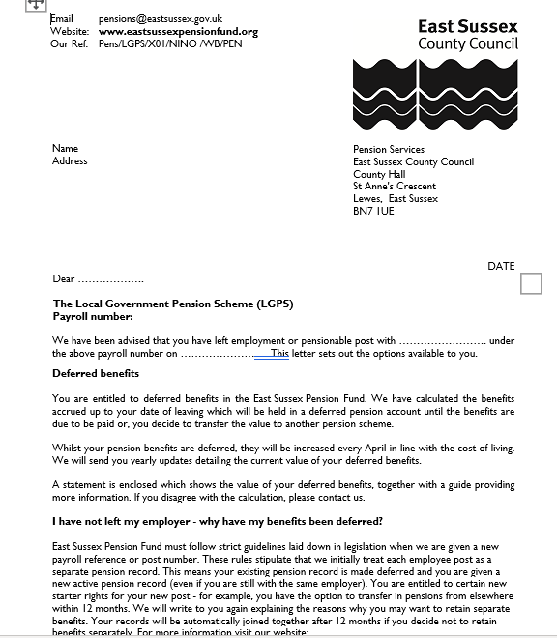
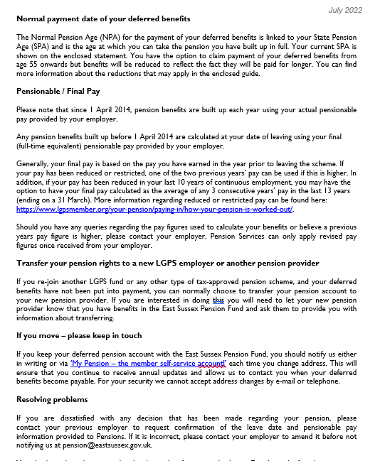
Employer Forum 2022

Slide 11
Questions?
Employer Forum 2022

