Slide 1
Ill health retirement
Employer Forum 2022
Robert Munro
Pensions Support Officer

Slide 2
Objectives
Employer Forum 2022
Overview of Employer responsibilities
What is an Independent Registered Medical Practitioner (IRMP)?
Benefits payable under Ill Health Retirement (IHR)
L&G’s Ill health insurance policy
Employer IHR Guide

Slide 3

Employer responsibilities
Employer Forum 2022
As the employer you are responsible for initiating the IHR process
Referring the individual onto your Independent Register Medical Practitioner (IRMP)
Providing information to the IRMP as per their request
Making the final decision on the award of IHR – HR Manager or equivalent
Providing ESPF with notice of decision, LGPS Ret2 form and relevant IHR Cert.
Notes:
The decision to refer someone down the IHR route is should be taken by the employer. This decision should be taken for entirely HR reasons. If an employee is unable to fulfil or carry out their duties due to ill health of mind or body then it is the employer who should decide whether the employment should be terminated – in this case by referring the individual for IHR assessment.
Once the decision has been taken to pursue IHR the individual should be referred to your Independent Registered Medical Practitioner for assessment – I will come back to this shortly.
Provide information to the IRMP to assist with their assessment – this may vary on a cases by case basis but should include details of illness/condition, absence records for previous two years, occ health reports, risk assessments and accident reports, job descriptions and any adjustments or adaptations. They may require medical reports from GP/Specialist for the individual.
The final decision - if awarded by the IRMP the employer should then in conjunction with any other relevant information take the decision to award IHR including which tier applies if an active member. This needs to be from person(s) responsible for signing this off within the employer.
The final step for the employer is to inform ESPF (pensions@eastssuex) of the decision along with a completed LGPS Ret 2 form and the relevant IHR cert.
Important to note that for deferred members (members who left prior to ill health) the employer is also responsible for referring these individuals to the IRMP. As they are no longer employees it is the individual themselves who requests referral through the employer. The employer has an obligation to refer the individual onto the IRMP and there is no limit to the amount of times an individual may apply. The employer is also responsible for the costs of the IRMP assessment for both active and deferred members.
Ret 2 – write out to member with estimate they then claim the benefits – then 9a confirming retirement

Slide 4

Independent Registered Medical Practitioner
Employer Forum 2022
An IRMP is required to assess IHR
This person should be appointed in line with our policy
They should have a diploma in occupational health medicine
They should be a member of the Faculty of Occupational Medicine
All IRMP’s appointed need to be approved by ESPF (Head of Pensions)
ESPF will keep a list of all IRMP’s notified by employers
Notes:
Who carries out the assessments?
An Independent Registered Medical Practitioner is required to carry out the assessment for IHR.
They should be appointed in line with our policy on the appointment of IRMP’s which can also be found on our website. This requires the IRMP to have a Diploma in Occupational Health Medicine or equivalent if from an EAA state and be a member of the Faculty of Occupational Medicine or equivalent if from an EAA state.
The policy also states you should inform the ESPF of your choice of IRMP for approval. We will then verify if they meet the criteria set out in the policy.
If you have yet to inform us of your IRMP please do so as soon as you can.

Slide 5
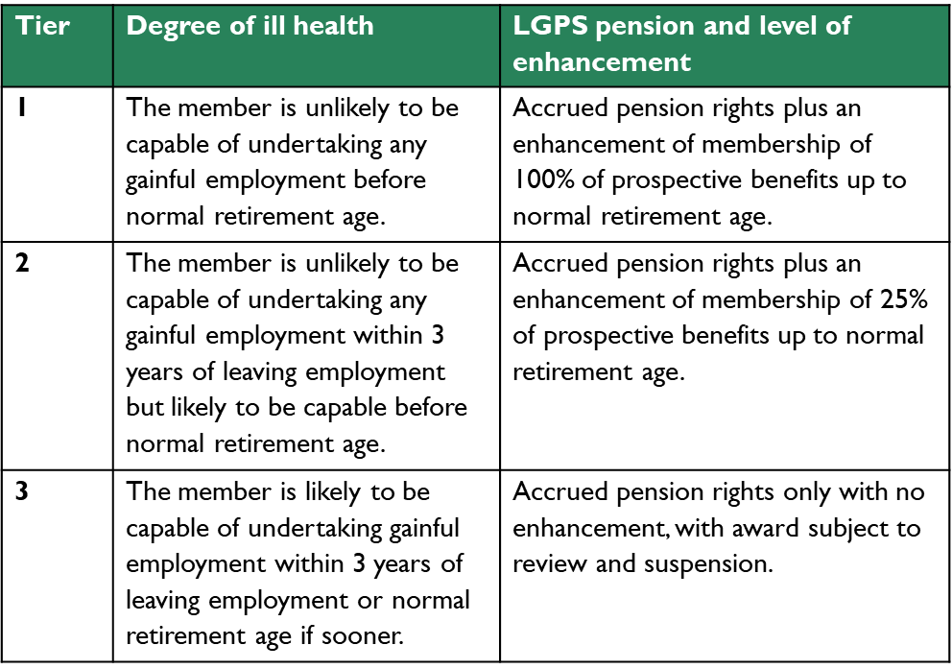
Benefits payable
Employer Forum 2022
Active - members with LGPS benefits who are currently employed.
Employees must have at least two years service or transferred benefits into the LGPS
Deferred members – not eligible for enhancement
Notes:
Tiers of IHR available for award:
Based on the criteria discussed:
All 3 tiers the member is deemed unable to carry out their duties due to ill health.
Tier 1 – if the member is unlikely to be capable of undertaking any gainful employment before normal retirement age. Tier 1 should be awarded. This award will result in the member receiving their accrued pension rights with an enhancement of 100% of their benefits up to retirement age.

Slide 6

Legal & General – Ill Health Liability Insurance
Employer Forum 2022
Key features
Policy from 1st April 21
Automatic enrolment for all small to medium employers (less than 200 active members)
Option to opt in to the policy for larger employers
Covers all Tier 1 and 2 strain costs for employers
New employers will be enrolled unless choose to opt out
Notes:
Majority of employers should be familiar with this policy.
The policy has been effective since 1st April 2021. The idea or aim behind this policy was to protect small and medium employers from large strain costs due to ill health retirement benefits. As we have seen with the previous slides this could be costly given that an award of Tier 1 would cost an employer there benefits accrued to retirement age plus a 100% enhancement of the benefits and a Tier 2 the full amount plus a 25% enhancement of the benefits.
A decision was taken to set up an insurance policy with L&G and we decided to auto enrol all small to medium employers into the policy. Employers continue to be enrolled should they have joined the scheme post April 21. Employers can of course opt out of the policy as well.
The insurance is not limited to this classification of employers any larger employer also has the option to opt in to the policy if they wish. There is no limit on the size an employer can be.
The policy covers all Tier 1 and 2 strain costs for employers.

Slide 7

How does the insurance work?
Employer Forum 2022
Cost – the premium for the insurance is covered by monthly contributions (no extra cost)
A successful claim is paid directly by L&G to the fund
Majority of claims (under £500k) the claim will be submitted by ESPF
Insurer may ask for additional information from employer
Notes:
How does it work?
The premiums for the insurance are covered by the monthly contributions and therefore does not come at an extra cost.
Any successful claims are paid directly to the Fund by L&G. The Fund will pay out on award of IHR and will not need to wait until the payment has been made to release the benefits due.
The majority of claims, any strain cost that is calculated to be under £500k, will be submitted by ESPF on behalf of you the employer. L&G require a IHLI Claim Form

Slide 8
Ill Health Liability Insurance - continued
Employer Forum 2022
Important to note
Policy will only cover claims initiated within the policy period
Policy does not cover deferred members or Tier 3 IHR
Claims over £500k:
  Requires direct employer/employee involvement (Part B IHLI Claim Form)
  Potentially requires involvement of Occupational Health or GP/Specialist
  90 days to submit claim*
All of the above information is included in Hymans Robertson - IHLI Insurance Guide found on our website
Notes:
Important aspects to note:
The policy will only cover claims initiated within the policy period. What is meant by this is the internal IHR process has to have begun within the policy timeframe so either 1st April 2021 or when you joined the scheme if a new employer.
The policy only covers active members for Tier 1 and 2. It does not cover deferred members or Tier 3 IHR. However, Tiers 1 and 2 will likely be significantly higher than the costs for deferred and Tier 3 members. The strain costs associated with deferred benefits are less likely to be high due to the lack of enhancement on them. For Tier 3 awards there is only a maximum of 3 years in which benefits are payable and these are also not enhanced.
Claims over £500k:
For these claims L&G will seek further information to verify the claim. This includes an additional section of the IHLI Claim Form. The pension fund will still complete Part A of this form, however, the Part B section of the form is required and involves input from the employer, employee and possibly occupational health adviser/IRMP. They may also request further information directly with you the employer and the member’s occupational health provider and/or doctor. The 90 days to submit the claim is relevant for all claims, however, is more crucial for these types of claims. This is because with those under 500k the fund will complete Part A of the form within days of receiving notification of an IHR decision. As the responsibility of completing Part B falls on you as the employer it is vital to know that you have 90 days from notification of the IHR decision to complete this section and submit this to L&G. All submissions can be done through Hymans. Please read IHLI guide for more info.

Slide 9

Ill health guide for employers
Employer Forum 2022
Found on ESPF website and covers:
Types of ill health retirement
Employer’s role
The role of the Independent Registered Medical Practitioner (IRMP)
The decision
Benefits payable
East Sussex Pension Fund – Ill health insurance policy – Legal and General
Appeals – Internal Dispute Resolution Procedure (IDRP)
Notes:
Just to finish:
The information shared today like the information on the insurance is available in a guide which explains this in more detail.
A guide for employers is now available on our website this details:
Types of ill health retirement
Employer’s role
The role of the Independent Registered Medical Practitioner (IRMP)
The decision
Benefits payable
East Sussex Pension Fund – Ill health insurance policy – Legal and General
Appeals – Internal Dispute Resolution Procedure (IDRP)
This also includes a list of certificates and where to find them on our website for IRMP’s to use.

Slide 10
Questions?
Employer Forum 2022
Contact us: employer.engagement@eastsussex.gov.uk

