Slide 1
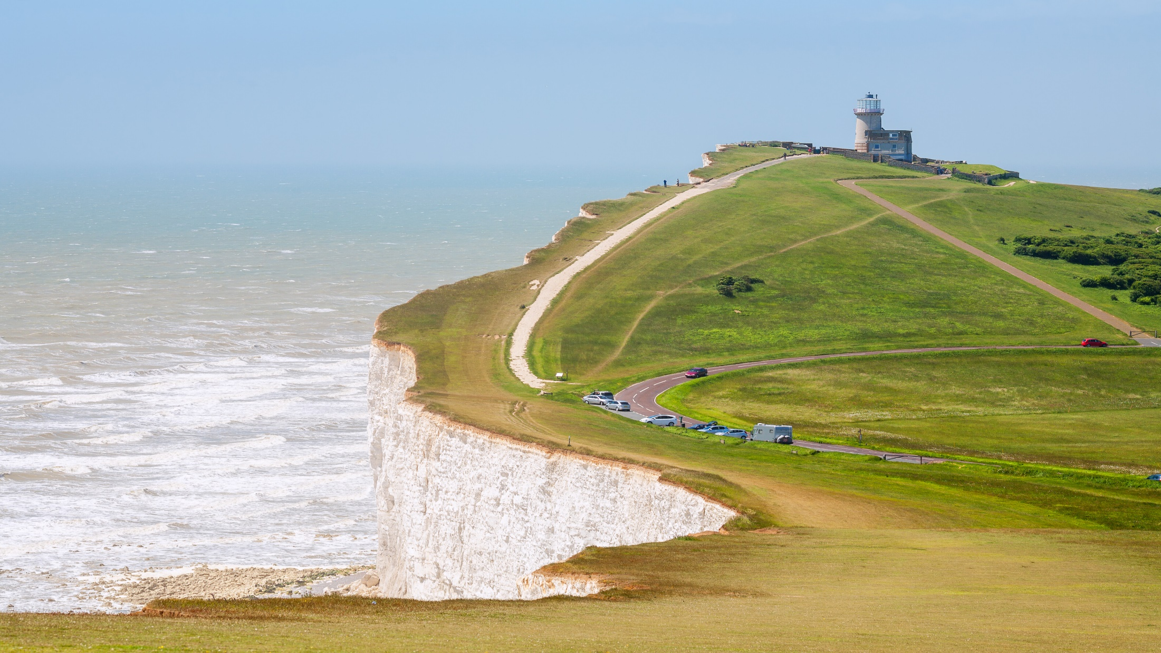

East Sussex County Council Pension Fund
Employer Forum
24 November 2022
Barry McKay, Partner
Karen Jamieson, Actuarial Assistant

Slide 3

You can change the image by right clicking on the existing image and select ‘replace image’.
A bank of available images can be found in the following folder:
\\bw-wan\efs\Marketing\CreativeDropbox\PowerPoint Image Library
Need further guidance?
Check out our ‘Creating impactful presentations’ document:
barnettwaddingham.sharepoint.com/PA/Marketing/Design/SiteAssets/SitePages/Home/Creating Impactful Presentations.pdf
What is a funding valuation
Assumptions
Whole Fund results and what’s next?

Slide 4
What is a valuation
There are three options for section dividers.
You can edit the number to reflect the number of sections you have
Try to use all three throughout your presentation to create variation
1
Need further guidance?
Check out our ‘Creating impactful presentations’ document:
barnettwaddingham.sharepoint.com/PA/Marketing/Design/SiteAssets/SitePages/Home/Creating Impactful Presentations.pdf

Slide 5
Types of actuarial valuation
Funding
Long-term view
Funding strategy statement
Accounting
External standard
Employer covenant
Fairness to each Fund
Cessation
Financial metrics
Exit credit or payment
Bulk transfer
Inconsistency between Funds

Slide 6
Key outcomes – funding position
Need further guidance?
Check out our ‘Creating impactful presentations’ document:
barnettwaddingham.sharepoint.com/PA/Marketing/Design/SiteAssets/SitePages/Home/Creating Impactful Presentations.pdf
Funding position
Funding level =
Assets / Liabilities
Surplus (Deficit) =
Assets - Liabilities

Slide 7
Employer contribution rates
Primary rate
Membership profile
Secondary rate
Reflects employer’s funding position and individual circumstances
Primary plus secondary
Total contribution rate
Stability objective
Surplus/deficit
Employer share only
Cost of future benefits
Long-term cost efficiency

Slide 8
Valuation project timescales
Need further guidance?
Check out our ‘Creating impactful presentations’ document:
barnettwaddingham.sharepoint.com/PA/Marketing/Design/SiteAssets/SitePages/Home/Creating Impactful Presentations.pdf
Aug-Sep 2022
Calculations
Member data
Cashflow data
Asset data
Employer data
Assumption setting
Whole Fund results
Oct-Dec 2022
Individual employer results
Employer Forum
Jan to Mar 2023
Final results
Funding Strategy Statement
Final valuation report and R&A
Pre March 2022
Valuation preparation
Early data checks and cleansing
Jun-Jul 2022

Slide 9
Why is data so important?
Cashflow data
Employee and employer contributions
Member data
Personal data e.g. dob
Accrued service and CARE
Employer information
Contracts for admission bodies
Pay for each member
(Really mean it about pay)
New members and leavers
Additional payments
MAT for academies
Risk arrangements

Slide 10
Importance of valuation data
WHAT ARE THE COSTS?
Age
Actual age: 53
Valued age: 63
Liabilities ~10%
Gender
Actual : F
Valued : M
Liabilities ~2%
Salary
Actual salary: £15k
Valued salary: £25k
Liabilities ~67%
Notes:
Louise introduces her breakout
Hand over to Melanie

Slide 11

Valuing liabilities for each employer
Assumptions about when benefits will be paid
Actuary builds model and runs (lots of) calculations
Member data for details of the benefits
Liability for each individual employer, in line with FSS
Assumptions about future amount of benefit

Slide 12

Valuing assets for each employer
Need further guidance?
Check out our ‘Creating impactful presentations’ document:
barnettwaddingham.sharepoint.com/PA/Marketing/Design/SiteAssets/SitePages/Home/Creating Impactful Presentations.pdf
Minus benefits paid out
Assets at the start of the period
Plus contributions paid in
Investment return – gain or loss
Assets at the end of the period

Slide 13
Assumptions
There are three options for section dividers.
You can edit the number to reflect the number of sections you have
Try to use all three throughout your presentation to create variation
2
Need further guidance?
Check out our ‘Creating impactful presentations’ document:
barnettwaddingham.sharepoint.com/PA/Marketing/Design/SiteAssets/SitePages/Home/Creating Impactful Presentations.pdf

Slide 14
Key actuarial assumptions
Demographic
Financial
Discount rate
Pension increases (CPI)
Salary increases
Mortality
Commutation
Retirement
If and when a payment is made
Amount of payment being made

Slide 15

Impact of increase in each assumption
Pension increases (CPI)
Salary increases
Discount rate
Increases liability for all members
All benefit payments are higher
Increases liability for active members
Final salary benefit payments higher
Reduces liability for all members
Investment return does more work
Notes:
To set background and help understand importance of key assumptions

Slide 16
Key financial assumptions – impact
Assumptions | 2022 valuation | 2019 valuation
CPI inflation | 2.9% | 2.3%
Salary increases | 3.9% | 2.3%
Discount rate | 4.6% | 4.0%
Difference between discount rate and CPI is key
Higher inflation and salary increases but higher discount rate
Similar to 2019 so impact on funding position is small

Slide 17
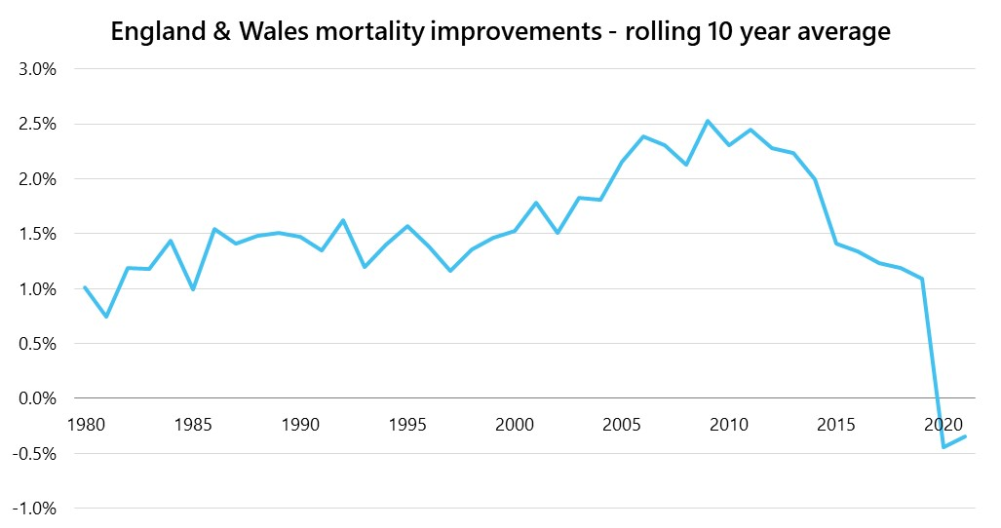
Future mortality improvements
Reduces liabilities | Mortality assumptions improve the funding position by 1.1% and reduce primary contributions by 0.5%
Notes:
OPTIONAL EXTRA SLIDE

Slide 18
Whole Fund results
3

Slide 19
2022 whole Fund results
Need further guidance?
Check out our ‘Creating impactful presentations’ document:
barnettwaddingham.sharepoint.com/PA/Marketing/Design/SiteAssets/SitePages/Home/Creating Impactful Presentations.pdf
Notes:
FUND SPECIFIC – PASTE WHOLE FUND RESULTS TABLE FROM RESULTS INCLUDING COMPARISON TO 2019

Slide 20
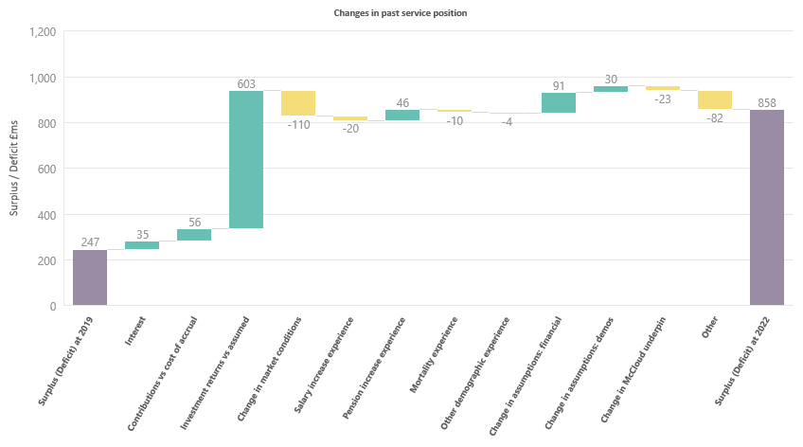
2022 whole Fund results
Need further guidance?
Check out our ‘Creating impactful presentations’ document:
barnettwaddingham.sharepoint.com/PA/Marketing/Design/SiteAssets/SitePages/Home/Creating Impactful Presentations.pdf
The key factors that have influenced the funding level of the Fund over the period are illustrated in the chart below.
Higher inflation
Higher discount rate
Strong returns
Notes:
FUND SPECIFIC – PASTE RECONCILIATION CHART FROM RESULTS

Slide 21
2022 primary rate (whole Fund level)
Need further guidance?
Check out our ‘Creating impactful presentations’ document:
barnettwaddingham.sharepoint.com/PA/Marketing/Design/SiteAssets/SitePages/Home/Creating Impactful Presentations.pdf
Using the proposed assumptions, the resulting average primary rate across the whole Fund is set out in the table below.
Primary rate | 2022 Proposed basis | Previous valuation
 | % of payroll p.a. | % of payroll p.a.
Average total future service rate | 26.7% | 24.4%
Less average member rate | 6.5% | 6.4%
Fund primary rate | 20.2% | 18.0%
Notes:
FUND SPECIFIC – PASTE WHOLE FUND PRIMARY RATE TABLE FROM RESULTS INCLUDING COMPARISON TO 2019

Slide 22
Key outcomes
Need further guidance?
Check out our ‘Creating impactful presentations’ document:
barnettwaddingham.sharepoint.com/PA/Marketing/Design/SiteAssets/SitePages/Home/Creating Impactful Presentations.pdf
Improved funding position
Increase in primary rate
Decrease in secondary rate

Slide 23
What affects employer contribution rates?
Primary rate
Membership profile
Secondary rate
Deficit recovery period
Employer covenant and funding targets
Stability
Funding risks
Risk-sharing or guarantees
Funding strategy statement
Regular lump sums, % of payroll, something else?
Employer share only
Solvency & long-term cost efficiency

Slide 24
Stabilising employer contribution rates
Councils
Academies
Increase/decrease of 1% of pay
Continue paying current rate
Colleges
Admitted bodies
Decrease of 1% of pay
Target rate of 18.9% of pay for pool
More variable but stable as possible

Slide 25



What’s happened since 31 March?
Sept CPI inflation of 10%
Funding approach is long term and robust to market volatility
Regular reviews at each actuarial valuation
Impact of mini-budget on markets
Changes in asset values
Notes:
Don’t expect to go through all the assumptions at the initial results meeting – only key ones and then the others are summarised at the back in an appendix. For detailed information then need to produce the assumptions document.

Slide 26
What next?
Employer results
FSS consultation
Report, R&A and FSS

