Slide 1
Pension Administration Team update
Employer Forum 2022
Paul Punter
Head of Pension Administration

Slide 2
Pensions Admin – Focus for 2022
Employer Forum 2022
Last year we said we would aim to achieve by now:
Formal scheme specific KPIs / SLAs implemented
Processes and procedures reviewed & documented
i-Connect to be rolled-out
Data Improvement Plan – Phase 3
Digital communications strategy
GMP reconciliation & rectification completed
Work on historical Annual Allowance reviews
McCloud project underway
Pay the right people the correct benefits in a timely manner
Continue to improve the member experience
Achieve both team and BAU targets

Slide 3
Performance – Oct 21 to Sep 22
Death notification acknowledged, recorded and documentation sent | 100% within 2 days
Award dependent benefits | 99.4% within 5 days
Retirement notification acknowledged, recorded and documentation sent | 94.4% within 7 days
Payment of lump sum made | 99.1% within 5 days
Calculation of spouse’s benefits | 97.8% within 5 days
Transfers in quote (aggregation cases 15 days) | 88.1% within 10 days
Transfers in payment (aggregation cases 25 days) | 97.6% within 5 days
Transfers out quote (aggregation cases 15 days) | 95.4% within 10 days
Transfers out payment (aggregation cases 25 days) | 83.9% within 10 days
Employer estimates provided | 96.2% within 15 days
Employer projections provided | 98.5% within 15 days
Refunds (including frozen refunds from August 22) | 93.5% within 10 days
Deferred benefit notifications | 98.7% within 15 days
Total task 9,267 of which 308 missed their target | 96.6% overall
New scheme specific PAT Key Performance Indicators introduced in October 2021

Slide 4
Pensions Helpdesk - Performance & call reasons Oct 21 to Sep 22
Employer Forum 2022
KPI | Fixed time fix | Call answer time | Abandoned call rate | Email response time
Gold Targets | 85% of enquiries dealt with at first point of contact | 75% of calls answered in 20 seconds | Less than 5% of calls abandoned | 100% of emails answered within 3 working days
Main helpline | 85.08% | 67.33% (Jul – Sep) | 1.92% | 100%
MSS helpline | 99.25% | 69.17% | 7.08% | 100%
Reason | 1st | 2nd | 3rd | 4th
Claim form guidance | 4 months | 3 months | 2 months | 2 months
Log-in issues | 4 months | 2 months | 3 months | 2 months
Leaver form | 3 months | 3 months | 0 months | 1 month
Self service activation | 1 month | 0 months | 3 months | 1 month
Update address | 0 months | 2 months | 2 months | 3 months

Slide 5
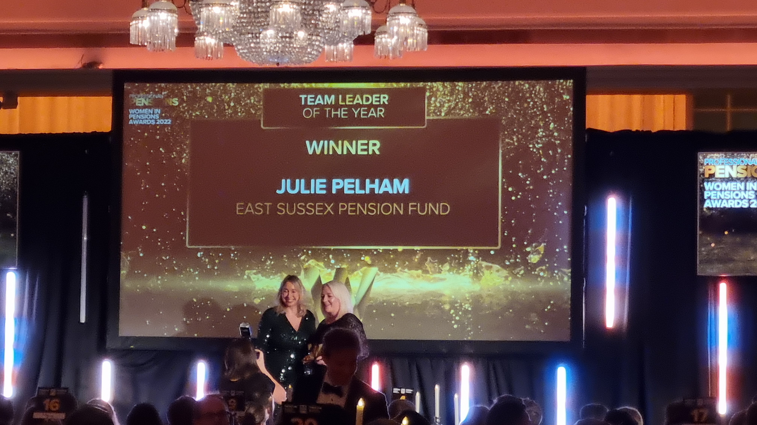
Professional Pensions – Women in Pension Awards 2022
Employer Forum 2022

Slide 6
Pension Administration focus for 2023
Employer Forum 2022
In 2023 the Pension Administration Team will be looking for much of the same in terms of hitting many of the same successes:
Excellent KPI/SLA performance & expand the MI coverage
Good Annual Benefit Statement results
Implement Pensioner CPI Pension Increases at 10.1%
Data Quality – high TPR validator common/conditional scores
address tracing exercises
Timely Annual Allowance exercise
Clean external audit & reasonable assurance rated internal audit
Process & procedures reviews complete and multiple robotics/automation projects underway
Revamp Member Self Service portal
Have a happy team ☺

Slide 7
Questions?
Employer Forum 2022

