Slide 1
i-Connect update
Employer Forum 2022
Paula Jenner
Pensions Engagement Officer

Slide 2
i-Connect recap
Employer Forum 2022
What is it?
i-Connect is a live cloud service for the flow of employee information from your payroll system to the Funds pension administration system
Benefits of i-Connect
Reduce the number of forms you are required to submit
Faster response to employer enquiries
Much faster processing of benefits for employees from real time data
A safe easy to use portal to transmit data securely
Remove the need to manually complete end of year reports

Slide 3
i-Connect and East Sussex Pension Fund
Employer Forum 2022
95 employers have already been onboarded onto i-Connect
Csv file upload (42) | Online return – manual (53)
For use by larger employers with more members | For use by smaller employers –usually under 40 members
File is usually populated with data pulled from your payroll system and then uploaded onto i-Connect monthly | Information is manually inserted directly onto i-Connect monthly
Intention to onboard all employers by the end of March 2023. Onboarding meetings: via Microsoft Teams but happy to do in person too.
.uk

Slide 4
i-Connect – some reminders
Employer Forum 2022
Please continue to submit monthly LGPS31 contribution forms
Phasing out of 8A leaver forms
Contact us if any errors or suppressions
Change of payroll provider – Please let us know so we can be involved early in the process

Slide 5
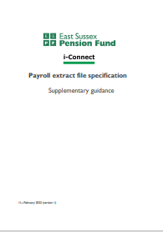
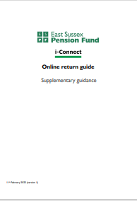
Specifications
Employer Forum 2022
ESPF Specifications
We have developed our own supplementary guide which sits alongside the Heywood’s specification document.

Slide 6
Issues to be aware of
Employer Forum 2022
Changing from 50/50 scheme to main scheme
Automated i-Connect reminders
Payroll reference changes

Slide 7
Updates and improvements
Employer Forum 2022
Future i-Connect changes and improvements will be communicated when required.
New i-Connect team in place
Now that i-Connect is more embedded into business as usual we will be working with larger employers on fine-tuning processes and i-Connect data collection

Slide 8
Questions? Contact us: employer.engagement@eastsussex.gov.uk
Employer Forum 2022

