Slide 1
Communication
Paul Linfield
Pensions Communication Manager
Notes:
Good afternoon.
I’d just like to take this opportunity to introduce myself.
My name is Paul Linfield and I joined East Sussex Pension Fund in Jan this year. My role as Pensions Communication Manager is new to the fund.

Slide 2
Communication objectives
Employer Forum 2022
Develop communication which is relevant and engaging and is also clear and easy to navigate.
Make the best use of technology where appropriate, to provide quicker and more efficient communications for the Fund's stakeholders.
Provide communication methods that are accessible to all.
Communicate using plain English in a clear, concise manner
To regularly evaluate the effectiveness of communications with key stakeholders with a primary focus on scheme members and employers and shape future communications appropriately.
To ensure members understand the valuable package of benefits available through the LGPS, are kept up to date with any changes in scheme benefits, can access scheme information and have an awareness of the overall investment strategy and performance of the Fund.
Notes:
As a Fund we have some high level communication objectives.
Read through bullets on slides.
Part of my remit as communication manager is to ensure that we adhere to these objectives with a primary focus on modernising the way we communication with members and employers.
It’s so important that we receive feedback directly from employers and members to make sure that what we provide, works for you, so don’t hesitate to contact me.

Slide 3
Key communication messages for employers
Employer Forum 2022
The LGPS is a valuable benefit for members and you need to help educate them to understand this
You need to understand how the Scheme works and the effect of any changes that occur
You have a responsibility to provide the Fund with information about any changes to scheme member circumstances and data in respect of your employees
You must comply with your LGPS employer responsibilities
To assist scheme employers participating in the LGPS, the Fund has a range of communication materials and methods that aims to increase your understanding of pension issues and help you fulfil your responsibilities as scheme employers.
Notes:
Moving onto employers there are a few key communication messages where we need your support.
The LGPS is one of the largest pension schemes in the UK. There are over 6 million members with 2 million of those paying in now. In Match 2021 the market value of the LGPS was £342 billion pounds.
It is a fantastic pension scheme. Individual’s pensions are not affected by how well investments perform as the Scheme provides a secure and guaranteed income every year when members stop working. As an employer it is important that your employees are made aware of what a great benefit they have.
You also need to have an awareness of how the scheme works and understand the implications of any changes that may occur.
You’ll find the importance of providing timely and accurate data as a running theme throughout the day as it’s essential to the calculation and payment of member benefits.
To help employers the Fund provides a range of communication materials. These aim to increase your understanding of the pension issues and help you fulfil your responsibilities as an employer in the Fund.
Everything we provide for employers is set out in our Communications Strategy.

Slide 4
Communication methods
Administration Strategy – details the obligations and responsibilities of both the Fund and the scheme employer to achieve a high-quality service.
Annual Report and Accounts - The audited accounts are published on our website, usually in early December.
Employer forum – provides information and training, investment performance, actuarial insights and current issues impacting the Fund
Employer newsletter – covers topical issues, technical information, changes to regulations that impact on your duties and responsibilities.
Funding and investment – provide and help employers understand the Funding Strategy Statement and Investment Strategy Statement including Fund performance
Guides - Employer contribution guide, HR guide, outsourcing and admission agreements guide, payroll guide, i-Connect and more
Training – The Fund are happy to support both group and individual training sessions for employers or your employees
Valuation Reports – a report issued every three years setting out the estimated assets and liabilities of the Fund as a whole, as well as setting out individual employer contribution rates
Website – A dedicated ESPF website with a specific page to support employers
Notes:
Talk through slide

Slide 5
Newsletters Surveys
Employer Forum 2022
Newsletter type | Date issued
Employer 1 | Feb 2022
Active member 1 | April 2022
Pensioner | May 2022
Employer 2 | June 2022
Employer 3 | September 2022
Deferred | December 2022
Active member 2 | December 2022
Employer 4 | December 2022
Survey type | Date issued
Employer | May 2022
Active member | June 2022
Pensioner | July 2022
Notes:
Since joining the Fund we have modernised the production of our member and employer newsletters which are now housed on our website.
We provide 4 employer newsletters throughout the year currently and also issue member newsletters to active, deferred and pensioners.
We had some excellent response rates on the member side of things but unfortunately the employer survey issued in May wasn’t brilliantly supported. You may have seen a paper survey in the paperwork today which we’d appreciate your views.
Since we’ve run the surveys we have already worked on a number of improvements:
Member self-service (MSS) – we now have a new page detailing how to register/retrieve user names/passwords etc and will be looking to implement some other quick wins’ (i.e. removing obsolete menus, refining wording etc).
Revised member and employer forms are now available – more on that shortly.
Employers asked for training on understanding the valuation process and funding strategy which we are covering today.
We have started to provide both member and employee training on the LGPS. Tim will cover this soon.
We are about to launch a brand-new Employer Toolkit as a direct result of employer feedback.

Slide 6
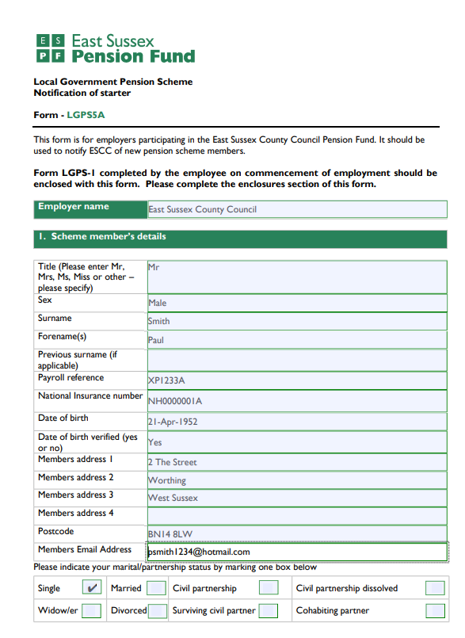
Forms
Employer Forum 2022
We now provide employer forms as:
1. Standard PDF - to print, complete and send.
2. Editable PDF - complete the form online and send via email
We can accept employer forms via email without the need for a handwritten signature if the email is sent:
• By a contact at the employer who is listed on the authorised signatories list, and
• From an employer email address e.g., John.smith@eastsussex.gov.uk
Notes:
Talk through slide

Slide 7
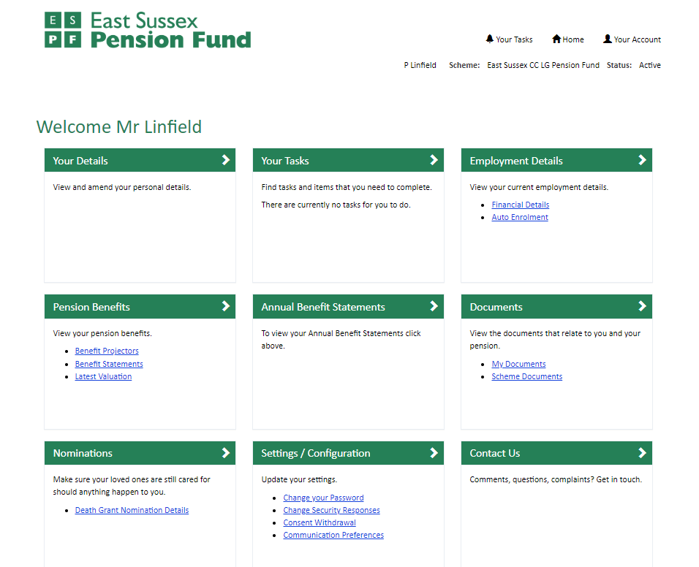
Website – My Pension
Employer Forum 2022
https://mypension.eastsussex.gov.uk/
Notes:
One of our pieces of major work in 2023 is to improve ‘My Pension’ the member self-service portal. In the meantime we will look to make some quick wins on the current version of the portal.
We would ask that you encourage members to register for ‘My Pension. Within MSS they can:
- Update personal information such as their address or bank details
- Amend or add who they want to nominate to receive benefits on death
- View Annual Benefit Statements(ABS) – keeping them up to date with the pension benefits they've built up
Use benefit projectors which can calculate the value of their pension:
. If they left the scheme
. If they retired before, at, or after their normal pension age
. If they died whilst working and hadn’t taken any benefits

Slide 8
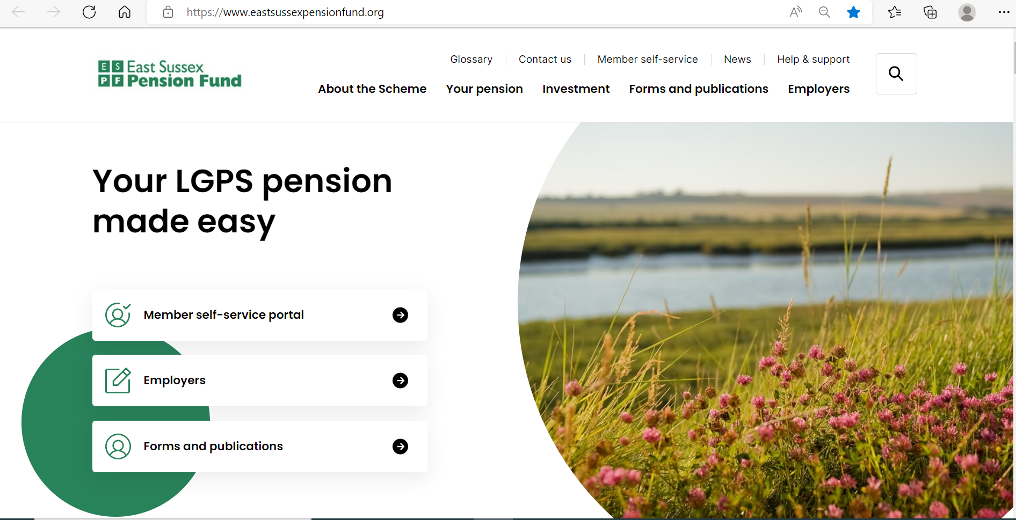
Website – East Sussex Pension Fund
Employer Forum 2022
www.eastsussexpensionfund.org
Notes:
I though it worthwhile giving you a quick run through of the East Sussex Pension Fund website.
Menus at the top
Homepage – talk through
Paying-in page – talk through
Investment – talk through
Form and publications – talk through
Employers – talk through page to the bottom
Then run employer toolkit video.

Slide 9
Website performance
Employer Forum 2022
ESPF launched a new website in September 2021
Online access to information is critical in today’s world and we’ve spent a lot of time this year building on the content
Notes:
The Fund launched a new website in September 2021. During 2022 we have made a lot of changes to the content within the site.
We will try wherever possible to direct employers and members to the website to obtain information. If you are struggling to find something or have any ideas for what you would like to see please let us know.
We continue to improve traffic on the website and are regularly picking up new visitors which is great.

Slide 10
Website – LGPS member site
www. www.lgpsmember.org

Slide 11
Employer Toolkit
Pointing you in the right direction
Notes:
Good afternoon.
I’d just like to take this opportunity to introduce myself.
My name is Paul Linfield and I joined East Sussex Pension Fund in Jan this year. My role as Pensions Communication Manager is new to the fund.

Slide 12
What is it?
A toolkit designed to support employers in the main processes and procedures they are responsible for under the Local Government Pension Scheme.
A set of documents covering five main categories – absence, accounting, administration processes, contributions, employer responsibilities, and retirement
Notes:
The Employer Toolkit is designed to support your understanding of the main processes and procedures you are responsible for under the Local Government Pension Scheme.
It doesn’t cover ever eventuality or every shred of detail but should give you a good grounding in the main subjects you are faced with on a regular basis. Importantly it will cover the steps you must take for key processes – retirement for example.
There are 25 documents split into 5 distinct categories – absence, accounting, administration processes, contributions, employer ‘musts’ and retirement.
If you are unsure of anything please reach out to the Employer Engagement Team, helpdesk or administration team and we’ll be happy to support.

Slide 13
What’s included?
ABSENCES
Authorised unpaid leave
APCs during absence
Child related leave
Sickness or injury
ACCOUNTING
IAS19 & FRS102 reporting
Triennial valuation
ADMINISTRATION PROCESSES
Death in service
Forms
Leavers
New starters
Opting out
Redundancy or efficiency cover
EMPLOYER RESPONSIBILITIES
Annual Benefit Statements
Auto enrolment
Discretions
Employer responsibilities - summary
i-Connect
CONTRIBUTIONS
50/50 section
Additional Pension Contributions
Additional voluntary contributions
Assumed Pensionable Pay
Pensionable Pay
RETIREMENT
Early Retirement
Flexible Retirement
Ill health retirement
Late retirement
Normal retirement
Notes:
We have tried to cover a range of topics based on feedback we’ve received from employers and our experience in analysing the most commonly asked questions we field.
We appreciate that the list is not exhaustive so we are happy for employers to let us know what’s missing. We see the Toolkit as an evolving concept.
Ultimately it’s to help you so please be forthcoming with any feedback so we can tweak the content accordingly.

Slide 14
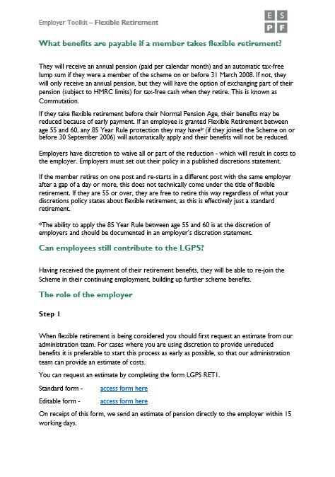
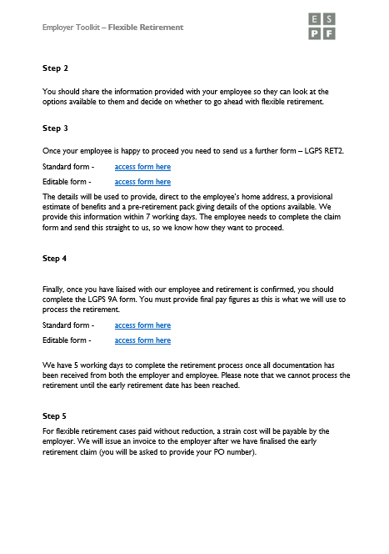
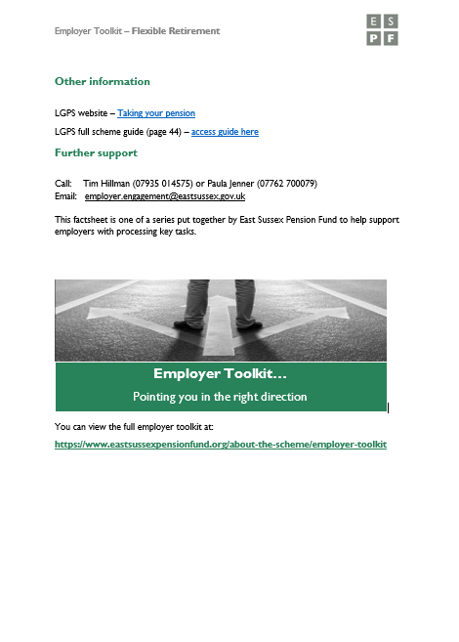
How do the toolkit documents look?
PDFs can be downloaded, printed
Notes:
Each topic is set out within the document in a similar format. So take Flexible Retirement as an example. The document contains:
1) An initial introduction of the subject in hand.
Your role as an employer including the key actions you are involved in
A set of helpful links to other sources of help which will allow you to delve deeper into the subject matter in hand in necessary
It is possible to download or print the PDFs if necessary.

Slide 15
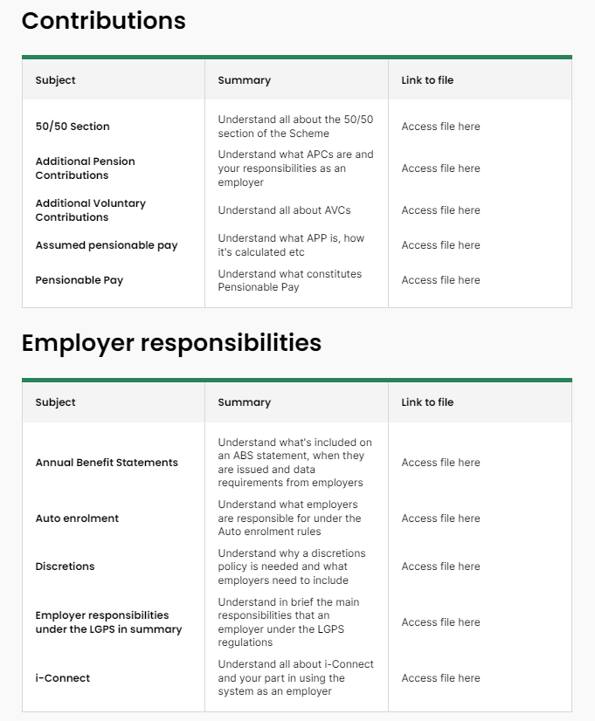
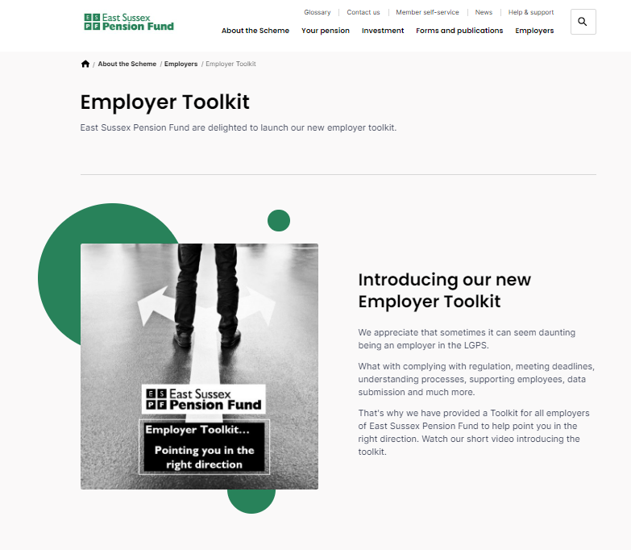
Where is it?
www.eastsussex.gov.uk/about-the-scheme/employer-toolkit
Notes:
The Employer Toolkit can be accessed via the Employer page of the website or directly using the link shown above.
There is a short introductory video explaining the concept of the toolkit which we suggest you watch initially.
You’ll see from the screen that we’ve split the page into different categories with subjects related to that category below. To access the documents you require simply click on the links provided.
That’s about all there is to it.
We hope that the Toolkit proves useful but as mentioned previously, please do let us have any feedback or suggestions for other topics you’d like our support on.
If you have any questions please contact either the Employer Engagement Team and we’ll be delighted to help.

Slide 16
Looking ahead
Focus on electronic communication methods
Enhanced member self-service functionality
Simplification of Annual Benefit Statements
Continued brand application
Improved accessibility across all communication
Simplifying retirement & transfer packs
Expand guides
Notes:
As we look ahead to 2023 we have a full communications agenda.
We will continue to concentrate of embedding digital methods of communication into our business as usual.
We will look to enhance the functionality and look and feel of the member self-service portal.
Annual Benefit Statements will be revised to make the information simpler.
We will continue to embed our look and feel across communications.
Accessibility is very important so that anyone regardless of abilities can access our information simply and easily.
We will be looking to simplify retirement and transfer packs.
And finally we’ll look to provide more simple guides in addition to the ‘Brief guide to the LGPS’ and the ‘Planning for retirement’ guide we have at the moment.

Slide 17
How can you help us?
Feedback – tell is what you want, what are you struggling with, are there certain communications where you need our support
Contact details – provide us with up to date email and home address details on all occasions
Keep yourself up to date – familiarise yourself with the website (particularly the employer page), read newsletters and other important communications from the Fund
Encourage members – to sign up for ‘My Pension’ refer them to the ESPF website, tell them about guides, make sure their contact details are up to date
Training – let us know if you or your employees required training

Slide 18
www.eastsussexpensionfund.org
Communication enquiries: paul.linfield@eastsussex.gov.uk

